Slide 1

Analyzing the U. S. Federal Reserve’s Dual Mandate
David Simbandumwe | DATA 698 Fall 2023

Slide 2
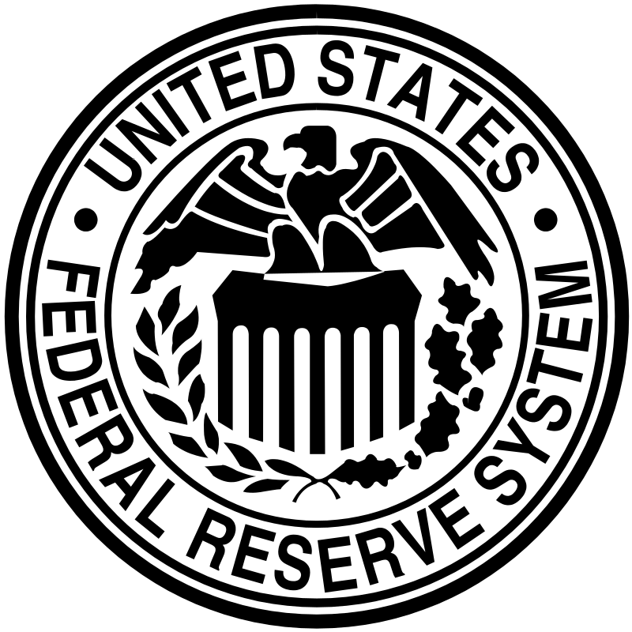

Central Banks and Monetary Policy
Managing monetary policy involves trade-offs and a balancing act among competing priorities. Central banks will define guiding principles or objectives
Primary objective of the ECB’s monetary policy is to maintain price stability
United States Federal Reserve Dual Mandate to maintain price stability and full employment

Slide 3
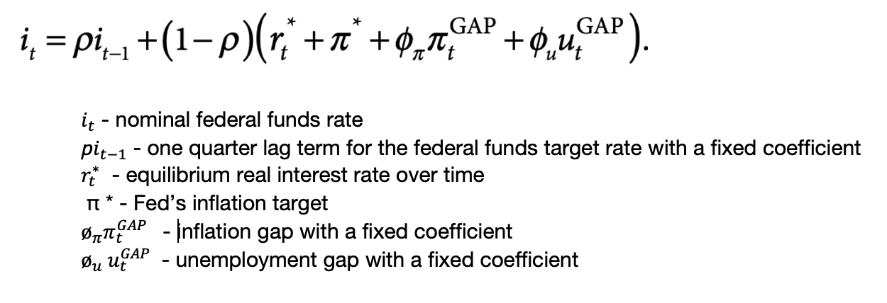
Balancing the Dual Mandate
The stated policy of the federal reserve is that they take a balanced approach to managing the dual mandate.
Modified Taylor Rule
John Taylor 1993

Slide 4
Research Question
Does the Federal Reserve follow a balanced approach to managing the dual mandate?
Approach
build regression models based on economic variables associated federal funds effective rate
explore the coefficients that represent the components of the dual mandate

Slide 5
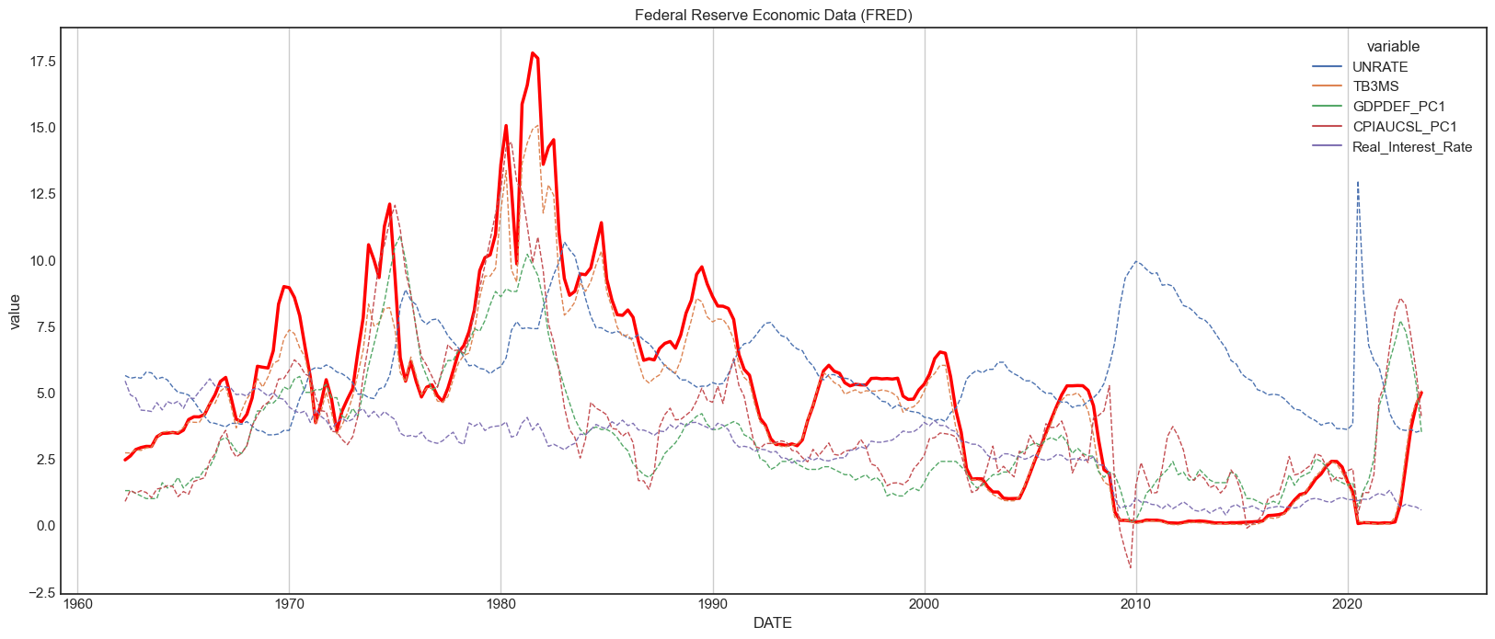
Data
The Federal Reserve Economic Data (FRED) comprehensive collection of U.S. and international economic time series data

Slide 6
Findings
In all models the coefficient associated with full employment is larger than the price stability coefficient
Economic cycles are not statistically significant
In general, the Federal Reserve Chair is not statistically significant with the exception of Volker
Negative relationship between the Real Federal Funds Rate and Inflation

Slide 7
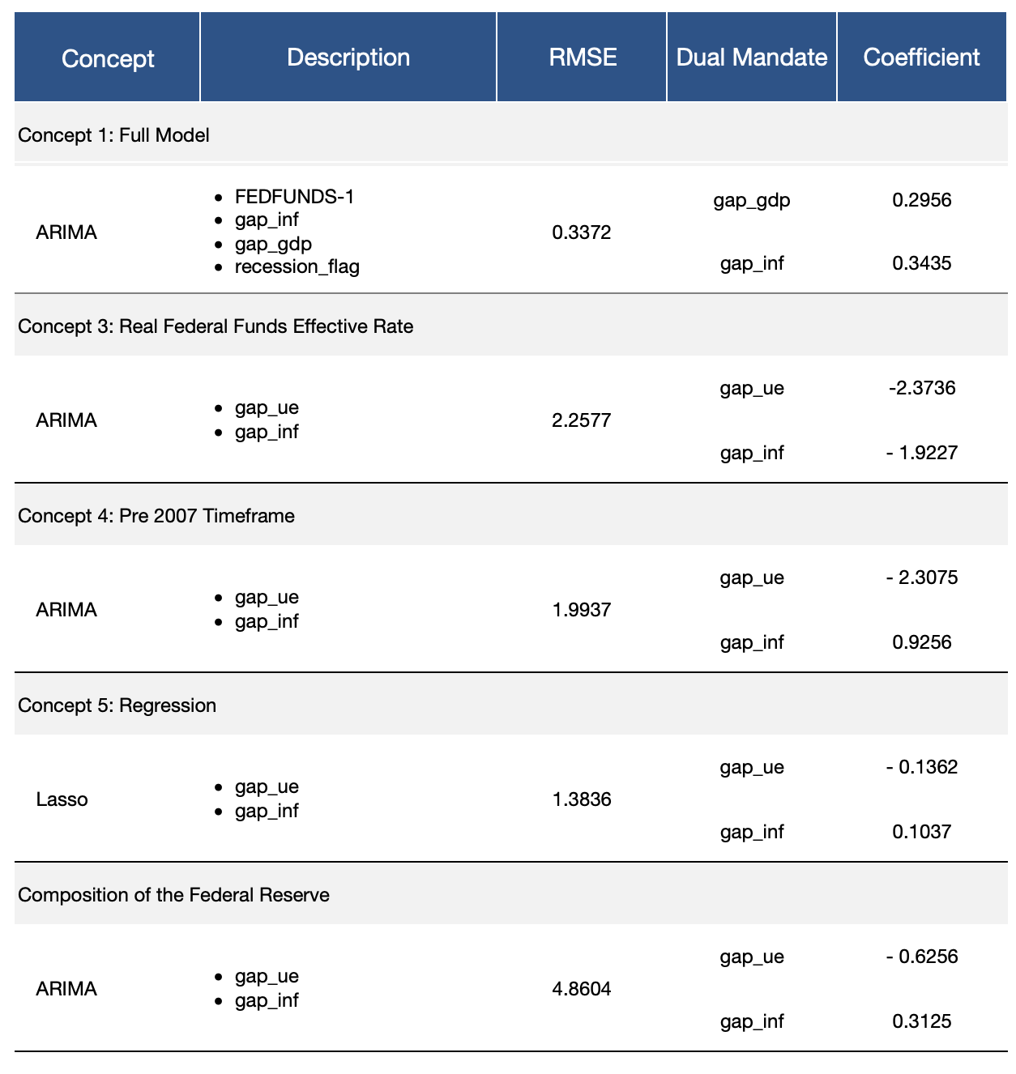
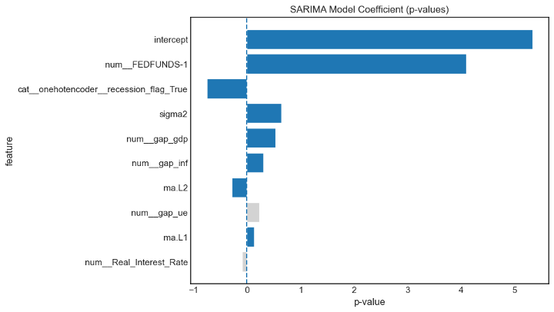
Coefficients
Focus on Full Employment - coefficient that captures full employment is larger than inflation coefficient in all models.
Seasonal Orders ARIMA models - the coefficients for the seasonal orders in the ARIMA model contribute to this observation

Slide 8
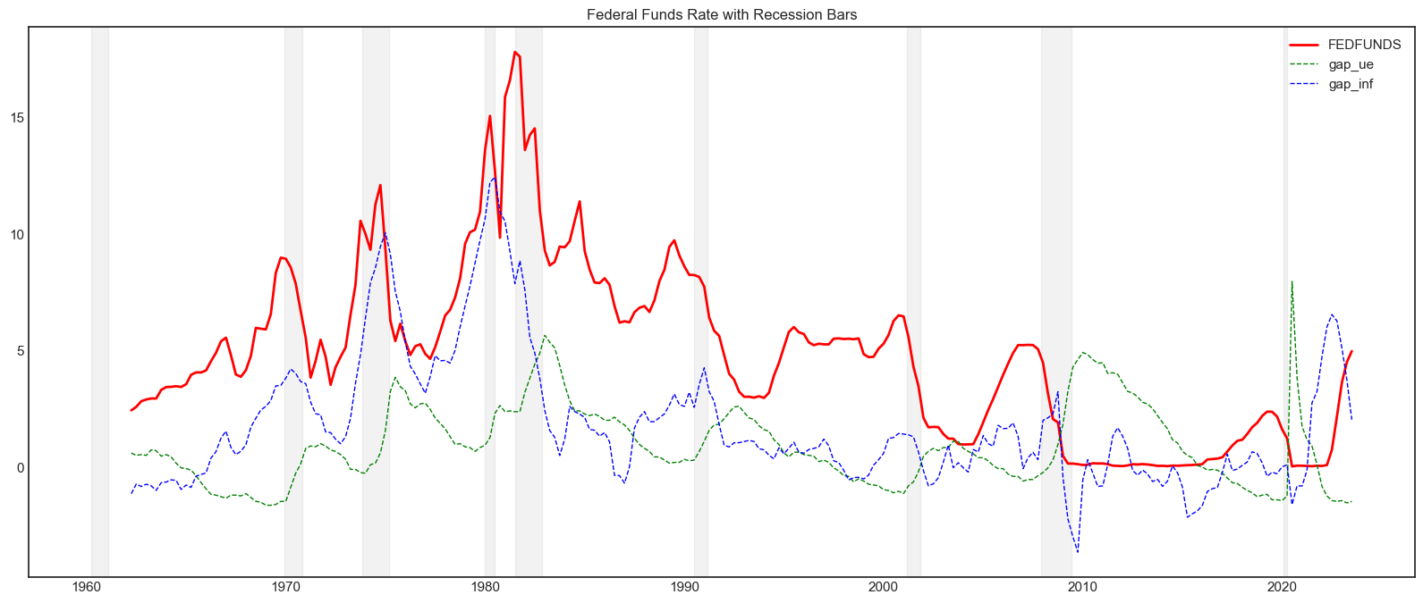
Economic Cycles
The recession flag is not statistically significant when it is included as feature

Slide 9
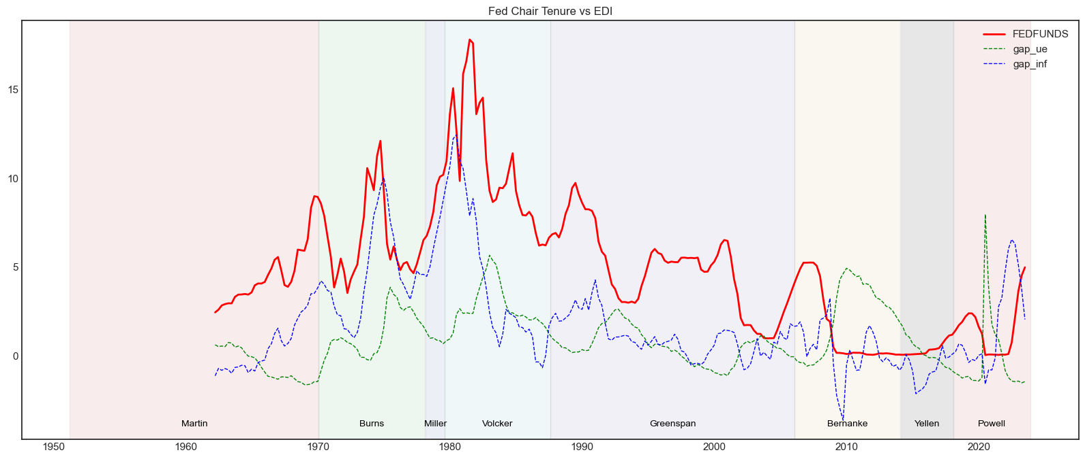
Federal Reserve Chair
The only dummy variable with statistical significance was Volker’s

Slide 10
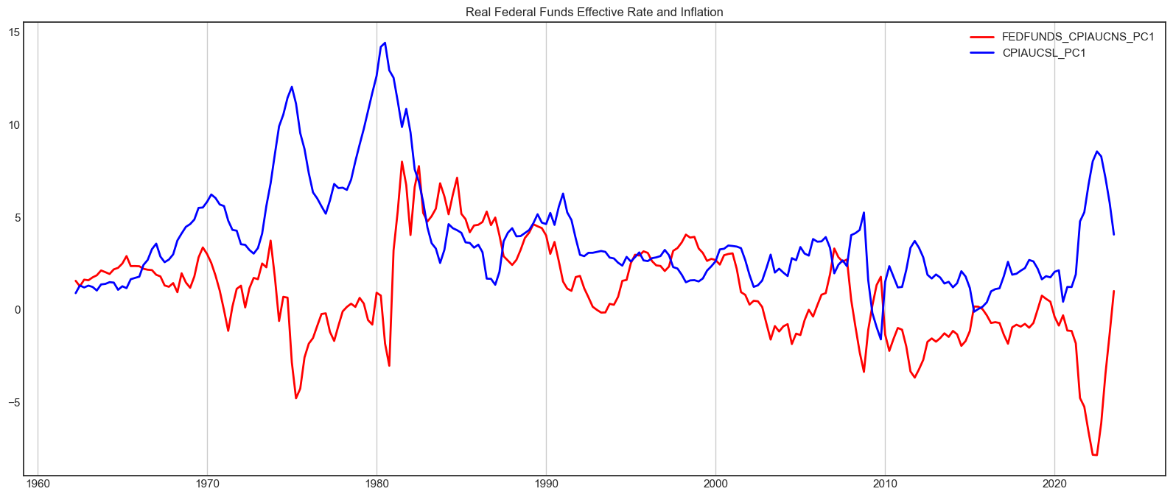
Federal Reserve Chair
Real Federal Funds Effective Rate and the Inflation rate has a -0.08 correlation.

Slide 11
Other Ideas
Analysis uses quarterly time periods aligning the data points with the economic calendar and the FOMC meeting calendar would be more accurate
Deeper dive into AR and MA coefficients
Explore different models GARCH, GLM or generalized method of moments (GMM)

